Slide 1
IBM Professional Certificate
Coursera Capstone Project

Slide 2




Timeline
Introduction to the topic of Traffic Analysis on the state of Kolkata in India.
Description of the Data sources required. Ex: from Wikipedia and Foursquare.
Final Result of the project.
Introduction
Business Problem
Data Required
Methodology
Result
Conclusion
Identification of the Business Objective and the problems people face.
The Industry standard approach called CRISP-DM and its utilization.
Conclusion and Future recommendation.

Slide 3
Introduction
India is a diverse country with vast variety of transportation systems with heavy reliance on it. One such gigantic network of transportation system is the Indian Railways network. States such as Delhi, Mumbai and Kolkata top the charts in the number of Railway stations and the total KM stretch.
The train stations serve as an ideal location for potential passengers and staff members to grab a bite and for the local retailers to generate some revenue out of it.

Slide 4
Business Case
The objective of this project is to identify the ideal food spots in the state of Kolkata where food stalls could be setup in order to maximize the footfall and generate potential revenue for the food stores.

Slide 5
Data Required
Proximity Data (Neighborhood Data):
This dataset is extracted from the Wikipedia page using the powerful package in Python called BeautifulSoup from bs4 Library.
Geocoding Data:
This file contains the information about the longitudes and latitudes and was retrieved into a pandas dataframe.
Venue Data (Foursquare API):
The final data obtained was from the Foursquare after passing the code and secret API to get the venue details.

Slide 6


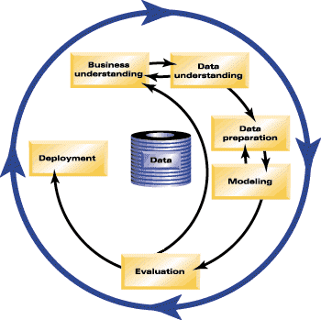

Methodology
CRISP-DM also known as Cross-Industry Standard Process for Data Mining, is an industry standard way to structure and organize the methodology for a Business Case. The same is used in this project.
The sequence of the phases is not strict. In fact, most projects move back and forth between phases as necessary.

Slide 7
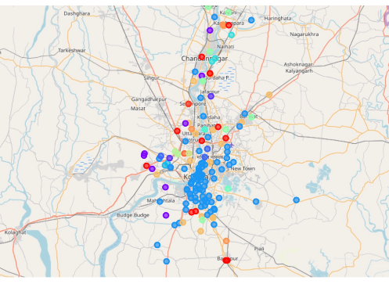
Result
An optimal value of n was found for KNN machine learning model which resulted in a successful clustering algorithm. This has been visualized in the Jupyter Notebook using a gamut of colors to make in identifiable.

Slide 8
Conclusion
The food places on the outskirts of Kolkata has lower footfall than the ones which are near the railway station.
Opening more and more food stalls in the near future specially near the major railway stations can not only fulfil the needs of the common passengers or the staff members but can also supplement the average profits of the food outlets. Having a higher footfall will flourish the revenue generated by the local food stores.

